Slide 1

NETFLIX CASE STUDY
A Research Project by INDRANI
Top Ranked Data Science & Analytics Education Provider Since 2007

Slide 2


index
Top Ranked Data Science & Analytics Education Provider Since 2007
Case Study Content
Project Synopsis
Dataset Features
Table Features
Objectives
Tool used for Data Analysis & Reporting
Output – Tables, Charts & Graphs
Conclusion

Slide 3
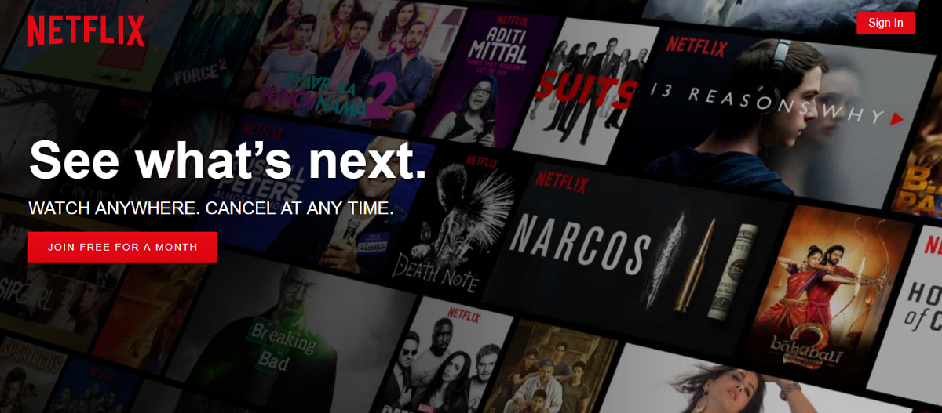
CASE STUDY CONTENT
Top Ranked Data Science & Analytics Education Provider Since 2007
NETFLIX is a popular streaming service that offers a wide variety of award-winning TV shows, movies, anime, documentaries, and more on thousands of internet-connected devices
– all for one low monthly/ yearly price.

Slide 4
PROJECT Synopsis
Top Ranked Data Science & Analytics Education Provider Since 2007
Exploratory data analysis & dig deep into the latest Netflix contents
The latest NETFLIX dataset has been used that has ratings and many other attributes to identify key parameters
Comparison and comprehensive judgements through data visualization

Slide 5
DATASET FEATURES
Top Ranked Data Science & Analytics Education Provider Since 2007
The dataset collected from Kaggle which combines data sources from Netflix, Rotten Tomatoes, IMDB, box office information, trailers on YouTube, and more using various APIs.
Dataset includes 1 table consisting of 25 fields and 15000+ records
This Dataset comprises details of Movies & Series listed on NETFLIX from 2015 to April 2021

Slide 6
TABLE FEATURES
Top Ranked Data Science & Analytics Education Provider Since 2007
The Data Table composed of 25 Fields/ headers -
Title
Genre
Tags
Language
Category (Series/Movie)
Hidden Gem Score
Country Availability
Runtime
Director
Writer
Actors
View Rating
IMDB Score
Rotten Tomatoes Score
Metacritic Score
Awards received
Awards Nominated for
Box Office($)
Release Date
Netflix Release Date
Production House
Netflix Link
IMDB Link
Summary
IMDB Votes

Slide 7
OBJECTIVES
Top Ranked Data Science & Analytics Education Provider Since 2007
To find correlations between ratings, votes, box office collection, and more
To find patterns around the Quality, Quantity and Popularity of Movies/ Series and their various characteristics like genre, awards, language etc.
To discover Hidden gems under different categories
To display the findings based on data analysis using SQL

Slide 8



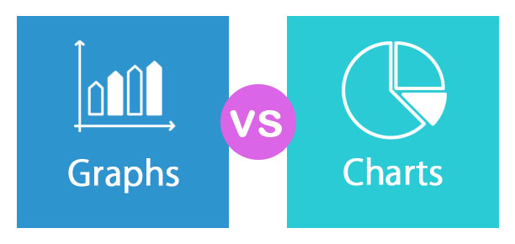
TOOLS USED – ANALYSIS & REPORT
Top Ranked Data Science & Analytics Education Provider Since 2007
SQL: Structured Query Language, which is a simple computer language for storing, manipulating and retrieving data stored in a relational database system.
MySQL – Free and Open Source RDBMS Software, which is being used here for the data analysis based on SQL.
MS EXCEL: Microsoft Excel is powerful data visualization and analysis software, which uses spreadsheets to store, organize, and track data sets with formulas and functions.
EXCEL is being used as a Reporting Tool (Charts & Graphs) for this project.
Notes:
SQL is used for sending any information to database, querying & performing various operations on the structured data stored in the databases like updating & deleting records, creating & modifying tables, views, etc.

Slide 9
OUTPUT – 1
Top Ranked Data Science & Analytics Education Provider Since 2007
Which among the 2 categories (Series vs. Movie) is more present in the Netflix product catalog?

Slide 10
OUTPUT – 2
Top Ranked Data Science & Analytics Education Provider Since 2007
Which are the top 3 genres which are mostly requested by the viewers or most popular within two categories?

Slide 11
OUTPUT – 3
Top Ranked Data Science & Analytics Education Provider Since 2007
Which are the hidden gems under the two main categories?

Slide 12
OUTPUT – 4
Top Ranked Data Science & Analytics Education Provider Since 2007
Which are the top rated Series and Movies based on IMDB score?

Slide 13
OUTPUT – 5 (Part i)
Top Ranked Data Science & Analytics Education Provider Since 2007
How the Rotten tomatoes score & Metacritic score is varying for each Series? What is the combined score?
…Cont’d

Slide 14
OUTPUT – 5 (PART II)
Top Ranked Data Science & Analytics Education Provider Since 2007
How the Rotten tomatoes score & Metacritic score is varying for each Movie? What is the combined score?

Slide 15
OUTPUT – 6 (PART I)
Top Ranked Data Science & Analytics Education Provider Since 2007
Does Rotten tomatoes score affect the box office return?
…Cont’d
Correlation Co-efficient = 0.28
Weak Correlation

Slide 16
OUTPUT – 6 (PART II)
Top Ranked Data Science & Analytics Education Provider Since 2007
Does higher Rotten Tomatoes Score imply higher box office collection?

Slide 17
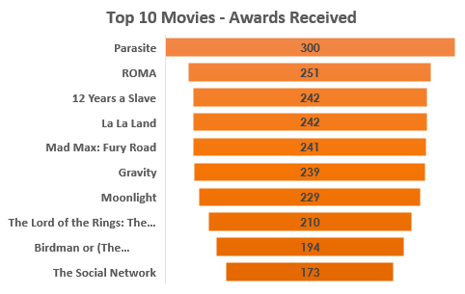
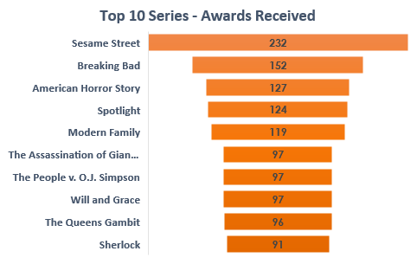
OUTPUT – 7
Top Ranked Data Science & Analytics Education Provider Since 2007
Which movies/series has received the most number of awards?

Slide 18
OUTPUT – 8
Top Ranked Data Science & Analytics Education Provider Since 2007
What is the Year-wise and Month-wise Total Box-office Collection for the FY 2020-21?
Year | Month | Total Collection
2020 | 42483461
April | 260233
May | 2215978
June | 172895
July | 1601312
August | 22869752
September | 497747
October | 2730523
November | 184477
December | 11950544
2021 | 4810790
January | 0
February | 0
March | 4810790
Grand Total for FY 2020-21 | 47294251

Slide 19
OUTPUT – 9
Top Ranked Data Science & Analytics Education Provider Since 2007
What is the Productivity per year on Netflix?

Slide 20
Output – 10
Top Ranked Data Science & Analytics Education Provider Since 2007
What is the proportion of Movies & Series based on different View Rating?

Slide 21
Output – 11
Top Ranked Data Science & Analytics Education Provider Since 2007
List the latest (2021) Korean Movies & Series sorted by month of release.
Category | Title | Release Month_2021
Movie | Miss Baek | February
Movie | Old Marine Boy | February
Movie | Outdoor Begins | February
Movie | A Tiger In Winter | February
Movie | Keys To The Heart | February
Movie | Homme Fatale | February
Movie | Happy Bus Day | February
Movie | Gonjiam: Haunted Asylum | February
Movie | After My Death | February
Movie | The Age of Blood | February
Movie | The Accidental Detective 2: In Action | February
Movie | 1987: When the Day Comes | February
Movie | Night of the Undead | February
Movie | Baby Beside Me | February
Movie | Pinkfong & Baby Sharks Space Adventure | January
Movie | Kingdom | January
Movie | What Happened to Mr. Cha? | January
Category | Title | Release Month_2021
Series | Do You Like Brahms? | March
Series | Vincenzo | February
Series | Hello, Me! | February
Series | Come Back Mister | January
Series | Running Man | January

Slide 22
Output – 12
Top Ranked Data Science & Analytics Education Provider Since 2007
Which Top 5 movies/series has received highest IMDB Rating sorted by IMDB Votes count Descending?

Slide 23
Output – 13
Top Ranked Data Science & Analytics Education Provider Since 2007
Is there any correlation between IMDB Votes and BOX Office?
Correlation Co-efficient = 0.77
Strong Positive Correlation

Slide 24
CONCLUSION
Top Ranked Data Science & Analytics Education Provider Since 2007
There’s a significant correlation between the parameters such as box office collection, IMDB Votes etc.
NETFLIX has an overall quantity-over-quality attribute
There are lots of Hidden Gems i.e. low review count & high rated Movie & Series listed on NETFLIX
There are more number of Movies available than Series
Drama is the most popular Genre in both Movie & Series categories
In 2020, most number of Movies & Series has been released on NETFLIX
August 2020 has received the highest Box office collection with a record of $2,28,69,752

Slide 25
Top Ranked Data Science & Analytics Education Provider Since 2007
THANK YOU

